Slide 1
PROJECT – ZEROTH REVIEW
Title of the Project:
Sovereign On-Premise Agentic AI Workbench using Open-Weight Multimodal LLMs for Confidential Industrial Work

Slide 2
ABSTRACT
Organizations such as refineries, public sector enterprises, defence-linked industries, and government offices handle large volumes of sensitive documents, engineering reports, internal code, scanned drawings, and confidential business information that cannot safely be processed using public cloud-based AI services. Existing AI assistants often depend on external infrastructure, limiting control over data privacy and model execution. This project proposes a Sovereign On-Premise Agentic AI Workbench, a self-hosted platform that combines multiple open-weight multimodal Large Language Models with intelligent model routing to select suitable local models for tasks such as document processing, coding, and visual understanding. The system uses an agentic orchestration layer to perform multi-step tasks by coordinating local tools for OCR, document processing, knowledge retrieval, calculations, sandboxed code execution, and file generation. A local Retrieval-Augmented Generation (RAG) component retrieves relevant information from organizational SOPs, manuals, reports, and other knowledge sources while keeping the data within the local environment. The system can process scanned documents and engineering images and generate practical deliverables such as Word, PowerPoint, and Excel files. Data sovereignty is further supported through local execution, audit logs, network monitoring, and restricted outbound communication. Together, these components aim to provide a secure, extensible, and practical alternative to cloud-based AI assistants for confidential industrial knowledge work.
Keywords: On-Premise AI, Agentic AI, Open-Weight LLMs, Multimodal AI, RAG, Data Sovereignty

Slide 3
LITERATURE SURVEY
Base paper:
T. Paloniemi, M. Setälä, and T. Mikkonen (2025). Porting an LLM based Application from ChatGPT to an On-Premise Environment. 2025 IEEE/ACM 22nd International Conference on Software and Systems Reuse (ICSR), Ottawa, ON, Canada, pp. 78–83, doi: 10.1109/ICSR66718.2025.00014.
Objectives:
  To develop an on-premise LLM-based system for processing confidential data within an organization's infrastructure.
  To integrate open-weight language models as an alternative to externally hosted AI services.
  To evaluate the feasibility of running LLM applications on local hardware.
  To improve control over data privacy, model execution, and system configuration.
  To design an extensible local AI environment that can be adapted to organizational requirements.

Slide 4
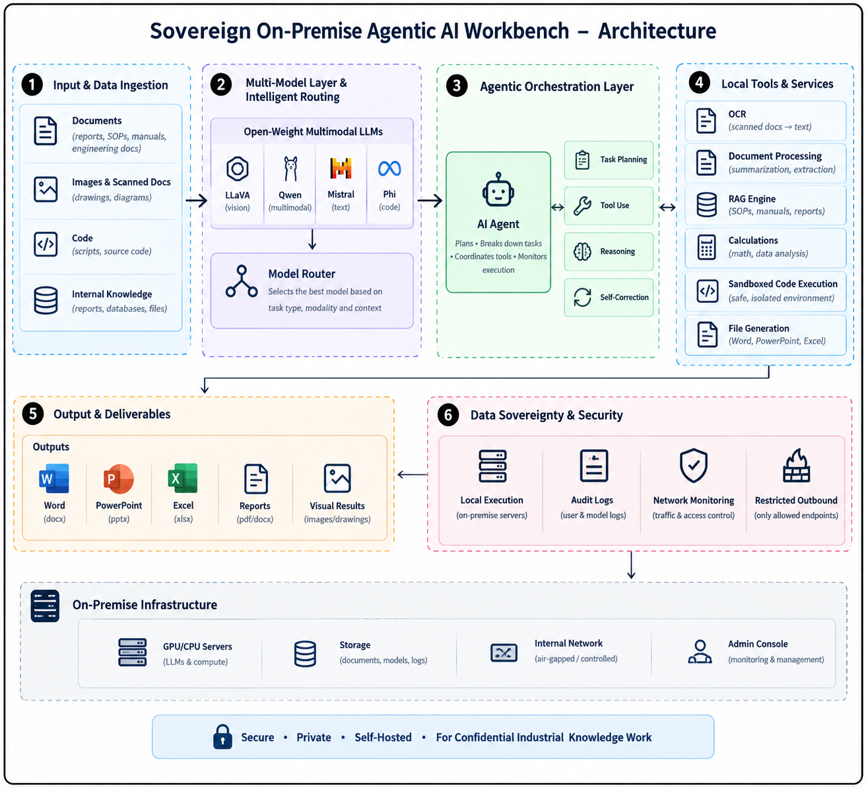
Architecture

